Slide 1

2GA3 Tutorial #6
DATE: October 29th, 2021
TA: Jatin Chowdhary

Slide 2
Midterm #1
What went wrong?
  ~66% average
    It should have been ~86%
Am I doing something wrong?
  Some students had trouble calculating the base address, offset, etc.
    How is this possible? I went over this 3 times
      Yet, some people still had trouble
      There are clear-cut examples in the slides
  Hopefully it was nobody in this class!

Slide 3
Take Action
You need to take your education into your own hands
  You’re paying a lot of money; so extract as much as you can!
DO whatever works for you
  Don’t listen to others
    You know yourself better than anyone (I hope)
Example:
  ST##.MP4

Slide 4
QUESTIONS???

Slide 5
Solution Manual
I found one
  But it’s for the previous edition
    (1st edition) (2017)
If you want it, here’s the link:
  https://pastebin.com/XiA209tH
    It’s only up/active for 30 days
      After ~30 days it will be automatically deleted
  Do not take their answers at face value
    There are typos/mistakes in the solution manual

Slide 6
Get Out...
… of your comfort zone
  If you don’t know the answer, just say it
    Ain’t nothing wrong with this
  If you have a rough idea, but you’re unsure:
    Take a deep breath
    Slowly explain what your thinking
NO MORE MUMBLING
No one gets it, the first time
  Literally no one – I don’t care if you’re Warren Buffett or Jimmy Buffett.
    So if you don’t understand something, keep asking until you get it
Make a lot of mistakes in class (or in practice)
  Then you’ll make less mistakes on the test, or when it really counts

Slide 7
Feedback
T01
  Literally no complaints
    Sad!
T02
  Only complaint: Time management
    I’m working on it
(T02 is my favorite section)

Slide 8
Invisible Slides
Used for homework questions
The answer will be on the next slide (or the same slide)
  But it will be invisible (kind of)
  Why? To get you to actually do the question
Reading the answer is totally different from answering the question from scratch
Example on next slide

Slide 9
Example (Invisible Slide)
Question: If Johnny had 3 apples, and he gave 2 apples to Timmy, and Timmy had a heart attack. Calculate the mass of the sun and show all of your work.
Answer:
  The value for G is 6.67 × 10⁻¹¹ N m²/kg² (where N is Newtons)
  The distance separating the Earth and the Sun (the orbital radius of the Earth around the Sun), r, is 1.5 × 10⁸ km
  The Earth's velocity around the Sun is just the total distance travelled divided by the time required for the Earth to make one complete orbit around the Sun, T
  The mass of the sun is: 1.98955 x 10³⁰ kg (rounded to 5 decimals)

Slide 10
Unary Number System
Recall unary is base-1
  i.e. 111111
    1 x 1⁶ + 1 x 1⁵ + 1 x 1⁴ + 1 x 1³ + 1 x 1² + 1 x 1¹
    (= 1 + 1 + 1 + 1 + 1 + 1)
Can we use a unary number system in a computer?
  I asked around and got mixed answers
    Some said yes, others said no, and some said it’s pointless
Turns out…
  Can have a voltage difference
  Cannot represent 0 or negative numbers without tricks
    Tricks may require compromises
  Lots of stuff needs to be re-invented
    i.e. Addition, Subtraction, Logic, etc.

Slide 11
QUESTIONS???

Slide 12
Hardware VS. Software (1)
Last tutorial there was a question (3.14) about calculating how many cycles an operation would take in hardware and in software
  Answer: Hardware takes less cycles than software
    However, both have advantages and disadvantages
Summary:
  On next slide

Slide 13
Hardware VS. Software (2)
Summary:
  Things implemented in software can be done in hardware
    What cannot be done? Self-modifying code
  Hardware implementation yields better performance, and it is more efficient
    Why? Because less abstraction (closer to the metal)
  It’s easy to change software, but difficult to change hardware
    Changing microcode requires re-flashing
      For consumer electronics this is basically impossible
  Software implementations are less reliable
    Possibility of more bugs/errors

Slide 14
QUESTIONS???

Slide 15
Real Life Example
Apple just released their M1 Plus/Pro/Max chips
  The battery life/performance is extremely misleading
    It does not represent real world use
  They claim up to ~20 hours of battery life
    But their testing methods are flawed!
      Why?
        Next slide!

Slide 16
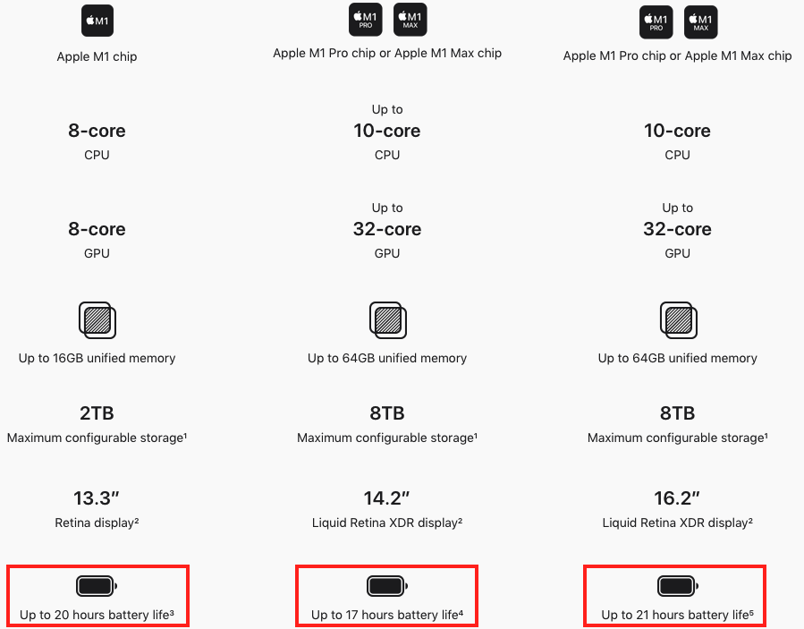

Slide 17
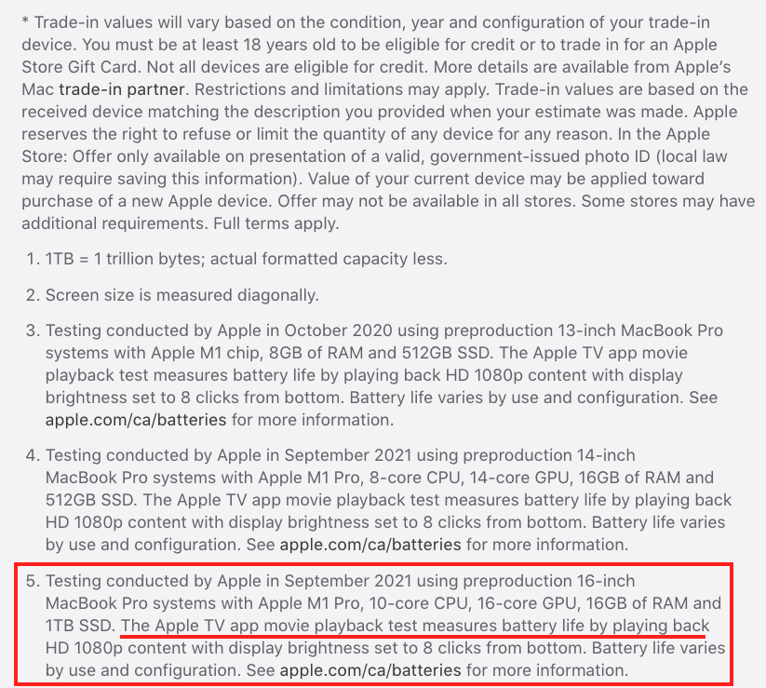
Apple’s battery life test does not mimic real world use
Playing a video on loop until the battery dies is not representative of normal use
If you thought this was misleading, wait till you see the next slide!

Slide 18
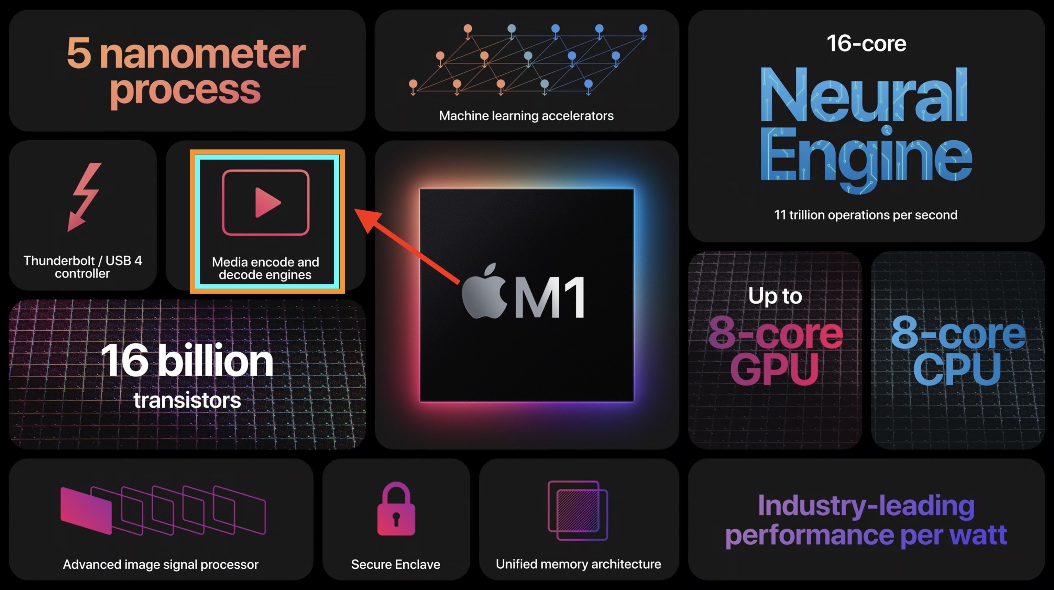
According to this infographic (from Apple) the M1 chip is able to encode and decode media (i.e. Video) in hardware
  But wait, didn’t we learn that things implemented in hardware have better performance than their software counterparts
    We also learned that things implemented in hardware are more efficient than software

Slide 19
That’s Misleading!
First of all:
  Apple’s battery life test revolves around looping a video for hours until the machine dies
    This does not represent real world use
  The M1 Plus/Pro/Max chip has a dedicated engine for encoding and decoding video
    It’s going to be (power) efficient
      Remember: Hardware implementation takes less cycles than software
So, battery life is going to be phenomenal
  But this is not accurate; it’s misleading

Slide 20
QUESTIONS???

Slide 21
Review Question #1
Question: Assume we have an 8-bit number stored in sign magnitude format. What is the range of possible numbers?
Options:
  A. [0, 127]
  B. [0, 128]
  C. [0, 255]
  D. [0, 256]
  E. [-127, 127]
  F. [-256, 255]

Slide 22
Explanation For #1
8 bit = 2⁸ = ???
  Number is signed, so values can be negative or positive
Sign-magnitude format: There are _ ways to represent 0
  From -127 to -0, there are 128 numbers
    [1111 1111, 1000 0000]
  From +0 to +127, there are 128 numbers
    [0000 0000, 0111 1111]
128 + 128 = 256

Slide 23
Review Question #2
Question: Assume we have an 8-bit number stored in two's complement. What is the range of possible numbers?
Options:
  A. [-128, 127]
  B. [-127, 127]
  C. [0, 255]
  D. [0, 256]
  E. [-128, 128]

Slide 24
Explanation For #2
Same logic as before, but:
  In two’s complement, there’s only _ way to represent 0
    Which is all 0’s
From [-128, -1], there are 128 numbers
  [1000 0000, 1111 1111]
From [0, 127], there are 128 numbers
  [0000 0000, 0111 1111]
128 + 128 = 256

Slide 25
Review Question #3
Question: What is the largest possible unsigned 10-bit number? What if the number was signed?
Options:
  A. 2¹⁰ – 1
  B. 2⁹ – 1
  C. 2⁸ – 1
  D. 2¹⁰
  E. 2⁹
  F. 2⁸

Slide 26
Review Question #4
Question: What is the largest possible unsigned 16-bit number?
Options:
  A. 32768
  B. 32767
  C. 0
  D. 65536
  E. 65535
  F. 2¹⁶ – 1

Slide 27
Review Question #5
Question: Assume we are adding two numbers, A and B, using saturation arithmetic. Both numbers are unsigned and 12-bits. If there is overflow (or saturation), what is the result?
Options:
  A. 4096
  B. 4095
  C. 0
  D. A + B
  E. 2¹² – A
  F. 2¹² – B
  G. None of the above

Slide 28
QUESTIONS???

Slide 29
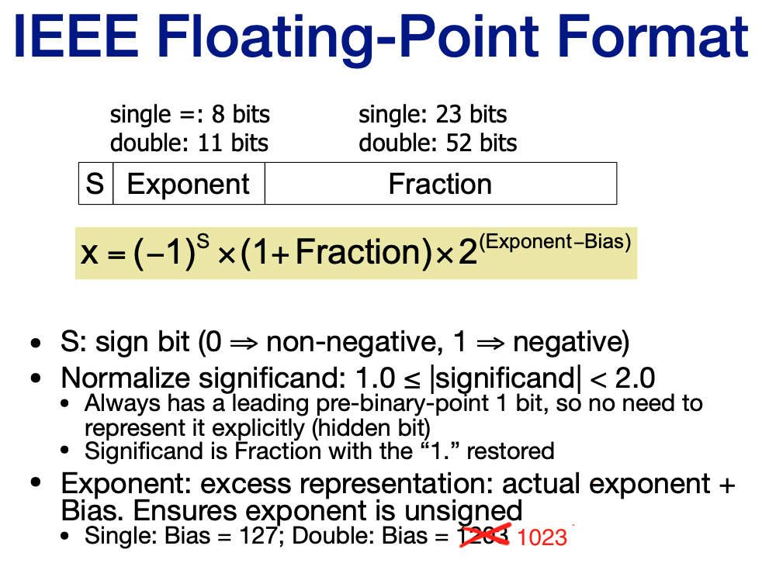
Recap About IEEE
This is from the lecture slides
The IEEE FP format is a way to rep. decimal num-
bers

Slide 30
Tutorial Question #1
Question: What decimal number does the following bit pattern represent? 0×0C000000
Recap:
  What is 0x?
    Hint: Hexadecimal
  What is the size of this bit pattern? (In bits)
    Hint: Recall that a hex character (letter/number) is 4 bits
  Convert the number to binary
  0x0C000000
    The sign is positive because the first bit is 0
      We know the first bit is 0, because the first 4 bits are 0

Slide 31
Answer For Question #1
Convert 0×0C000000 to binary
  0000 1100 0000 0000 0000 0000 0000 0000
Remember that the IEEE FP format is:
  (−1)^{S} x (1 + Fraction) x 2^{(Exponent−Bias)}
    1-bit for the sign
    23-bits for the fraction
    8-bits for the exponent
    1 + 23 + 8 = 32
Now, let’s break this binary number down based on the IEEE FP format
  Next slide!

Slide 32
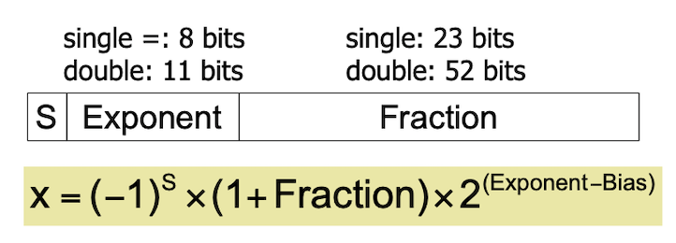
Answer For Question #1
The IEEE FP format is:
  (−1)^{S} x (1 + Fraction) x 2^{(Exponent−Bias)}
Bit-for-bit, the number is:
  0 0001 1000 0000 0000 0000 0000 0000 000
0
  This is the sign bit
    0 → Positive (non-negative)
    1 → Negative
  We apply it to the first part of the IEEE FP format:
    (-1)^{s} → (-1)º → 1
  Now, we have:
    (1) x (1 + Fraction) x 2^{(Exponent−Bias)}

Slide 33
Answer For Question #1
0001 1000
  This is the exponent part
  The number, in decimal, is: 24
    But we need to apply the bias
  Actual exponent = Biased exponent – bias
    Recall: The bias for a 32-bit IEEE FP number is 127 (= 2⁷ – 1)
      What’s the point of a bias?
    Actual exponent = 24 – 127 = -103
So far, we have:
  (1) x (1 + Fraction) x (2⁻¹⁰³)

Slide 34
Answer For Question #1
0000 0000 0000 0000 0000 000
  This is the fraction
    Value = x.00000000 (…)
  But wait! There’s a hidden 1
    Remember, it’s (1 + Fraction)
      The mantissa is one bit longer than its sequence of bits written in the number
Now, we have:
  (1) x (1 + 0.0) x (2⁻¹⁰³)
Putting it all together, we get:
  (1.0) x (2⁻¹⁰³)

Slide 35
QUESTIONS???

Slide 36
Tutorial Question #2
Question: Write down the binary representation of the decimal number 63.25 assuming the IEEE 754 single precision format.
Recap:
  The number is 63.25
  Convert to binary
    Using IEEE 754 single precision format
  Sign is positive
  Bias = 127
    Because single precision format

Slide 37
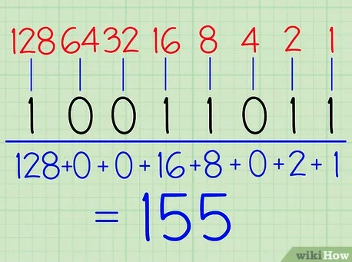
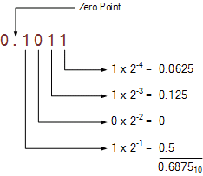
Answer For Question #2
Normalize 63.25
  63.25 x 10⁰
Convert to binary
  (63)10 = (111111)2
    2⁵ + 2⁴ + 2³ + 2² + 2¹ +2⁰
  (0.25)10 = (0.01)2
    0 x 2⁻¹ + 1 x 2⁻²
Putting these 2 together, we get:
  111111.01 x 2⁰
Move the floating point to the left, 5 times
  111111.01 x 2⁰ → 1.1111101 x 2⁵
Everytime we move the decimal point to the left, the exponent is incremented
If we move the decimal point to the right, the exponent is decremented
It’s like we’re taking from one side and giving it to the other

Slide 38
Answer For Question #2
So far, we have:
  1.1111101 x 2⁵
Recall: What is the sign bit?
  Positive or negative?
Now, we calculate the biased exponent:
  Recall from last question:
    Actual exponent = biased exponent – bias
  Biased Exponent = Actual exponent + bias
    Biased Exponent = 5 + 127 = 132

Slide 39
Answer For Question #2
Note: The ++ means concatenation
  It does not mean addition
IFF the number was negative, like -63.25, then the sign bit would be 1
We can add as many zeros as we want to the right side of the decimal point
  The value does not change
    i.e. 1.0 == 1.00 == 1.000
      But some people may argue that it affects precision
Let’s put it together!
  Currently, we have: 1.1111101 x 2⁵
Remember that the IEEE FP format for binary is:
  S ++ Exponent ++ Fraction
    Sign bit (1-bit)
      0 (Because the number is positive)
    Biased exponent (8-bits)
      132 = 127 + 5
      (132)10 = (1000 0100)2
    Fraction (23 bits)
      The fraction component is everything to the right of the decimal point
        1.1111101 x 2⁵
      What happens to the 1?
        ‘‘It’s a hidden 1’’
          (1 + Fraction)
Answer: 0 1000 0100 1111 101 0000 0000 0000 0000
  Fill in the remaining spots with 0’s

Slide 40
Answer For Question #2
Answer: 0 1000 0100 1111 101 0000 0000 0000 0000
Convert to hex:
  Remove spaces:
    01000010011111010000000000000000
  Add a space every after 4th bit, starting from right side
    0100 0010 0111 1101 0000 0000 0000 0000
  Every bit corresponds to a hex character (number/letter)
    0100 0010 0111 1101 0000 0000 0000 0000
    4 2 7 D 0 0 0 0
  Final answer (in hex): 0x427D0000
    What does 0x mean?

Slide 41
Tutorial Question #3
Question: Write down the binary representation of the decimal number 63.25 assuming the IEEE 754 double precision format.
Answer:
  Homework!
  Logic is similar to previous question
    If you can do single precision format, you can do double
  Answer on next slide, but don’t blatantly read it!

Slide 42
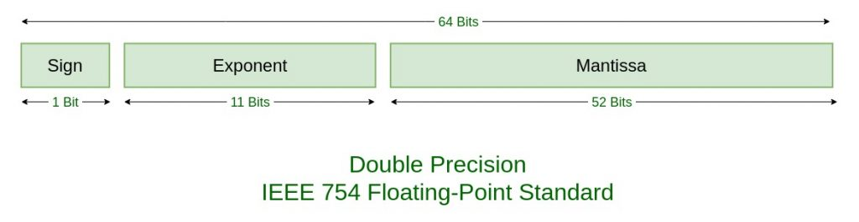
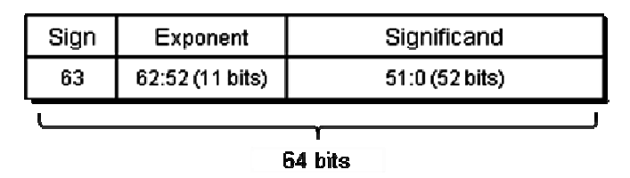
Answer For Question #3
Precursor:
  The number given is (63.25)10
  Convert to IEEE 754 double precision format
  For double precision:
    Sign
      1-bit
    Exponent
      11-bits
    Fraction
      52 bits
    1 + 11 + 52 = 64
    Bias = 1023
      1023 = 2¹⁰ – 1

Slide 43
Answer For Question #3
Answer (1):
  Rewrite:
    63.25 → 63.25 x 10⁰
  Convert to binary
    63.25 x 10⁰ → 111111.01 x 2⁰
  Normalize (move the decimal point)
    111111.01 x 2⁰ → 1.1111101 x 2⁵
      Decimal point moves 5 places to the left
      For every left shift, the exponent increases by 1
        For every right shift, the exponent decreases
  Sign (1-bit)
    63.25 is positive, so sign bit is 0
      If the sign bit is 0, the number is positive
      If the sign bit is 1, the number is negative
  Exponent (11-bits)
    See right side
Answer (2):
  Exponent (11-bits)
    Biased exponent = Actual exponent + bias
    Biased exponent = 5 + 1023 = 1028
      (1028)10 → (10000000100)2
  Fraction = 1.1111101 x 2⁵
    The fraction is 52-bits
    The fraction is everything to the right of the decimal point
    The 1 becomes ‘‘hidden’’
  IEEE Format:
    S ++ Exponent ++ Fraction
      The plus is concatenation, not addition!
  Put it all together:
    0 10000000100 1111101 0 0000 0000 0000 0000 0000 0000 0000 0000 0000 0000 0000
  Convert to hex:
    0x404FA00000000000

Slide 44
QUESTIONS???

Slide 45
Tutorial Question #4
Question: IEEE 754-2008 contains a half precision that is only 16-bits wide. The leftmost bit is still the sign bit, the exponent is 5-bits wide and has a bias of 15, and the mantissa is 10-bits long. A hidden 1 is assumed. Write down the bit pattern to represent −1.5625 ×10⁻¹ assuming a version of this format, which uses an excess-16 format to store the exponent.

Slide 46
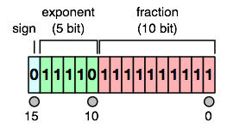
Answer For Question #4
First of all, we are doing the exact same thing as the previous questions. The only difference is the precision, which is basically the size.
  Since we are dealing with a 16-bit format, the exponent and fraction will be smaller. However, the sign bit is still 1-bit.
    Regardless of size, the sign-bit will always be 1.
      This assumes that the size is big enough to accommodate a decent.
  So far, you’ve dealt with single (32-bits) and double (64-bits) precision – now you are dealing with half a precision (16-bits)
    But, the exact same logic applies!

Slide 47
Answer For Question #4
Recap:
  The format is IEEE-754 2008
  16-bits wide
  Leftmost bit is sign-bit
    Sign bit is 1-bit
  Exponent = 5-bits
    Bias = 15 = 2⁴ – 1
  Mantissa = 10-bits
    Hidden 1 is assumed

Slide 48
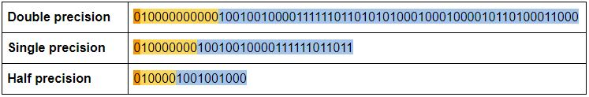
Answer For Question #4
So what’s different?
  Instead of 32-bits wide, it’s now 16-bits wide
  Exponent is 5-bits, instead of 8-bits
  Fraction is 10-bits, instead of 23-bits
What hasn’t changed?
  The sign bit
    It’s still 1-bit
BUT, it’s the same logic/format, but different numbers/size
  Refer to image, below:

Slide 49
Answer For Question #4
Answer:
  Rewrite (to represent 10⁰)
    –1.5625 x 10⁻¹ → –0.15625 x 10⁰
  Convert to binary and normalize
    –0.00101 x 2⁰ → –1.01 x 2⁻³
      When normalizing a binary number, the format should be:
        (1.fraction) x 2^{y}
  Calculate the bias exponent
    Biased exponent = Actual exponent + bias
    Biased exponent = –3 + 15 = 12
  Sign bit
    –1.5625 is a negative number
      Therefore, the sign bit is 1
Answer:
  Exponent
    The biased exponent is 12
    (12)10 = (01100)2
  Fraction
    –1.01 x 2⁻³
    The fraction is (01)2
  Put it all together:
    S ++ Exponent ++ Fraction
      1 01100 01 0000 0000
        We fill in the remaining 8-bits with zeros, because it is after the floating/decimal point
  Convert to hex:
    (1011 0001 0000 0000)2 → (B100)16

Slide 50
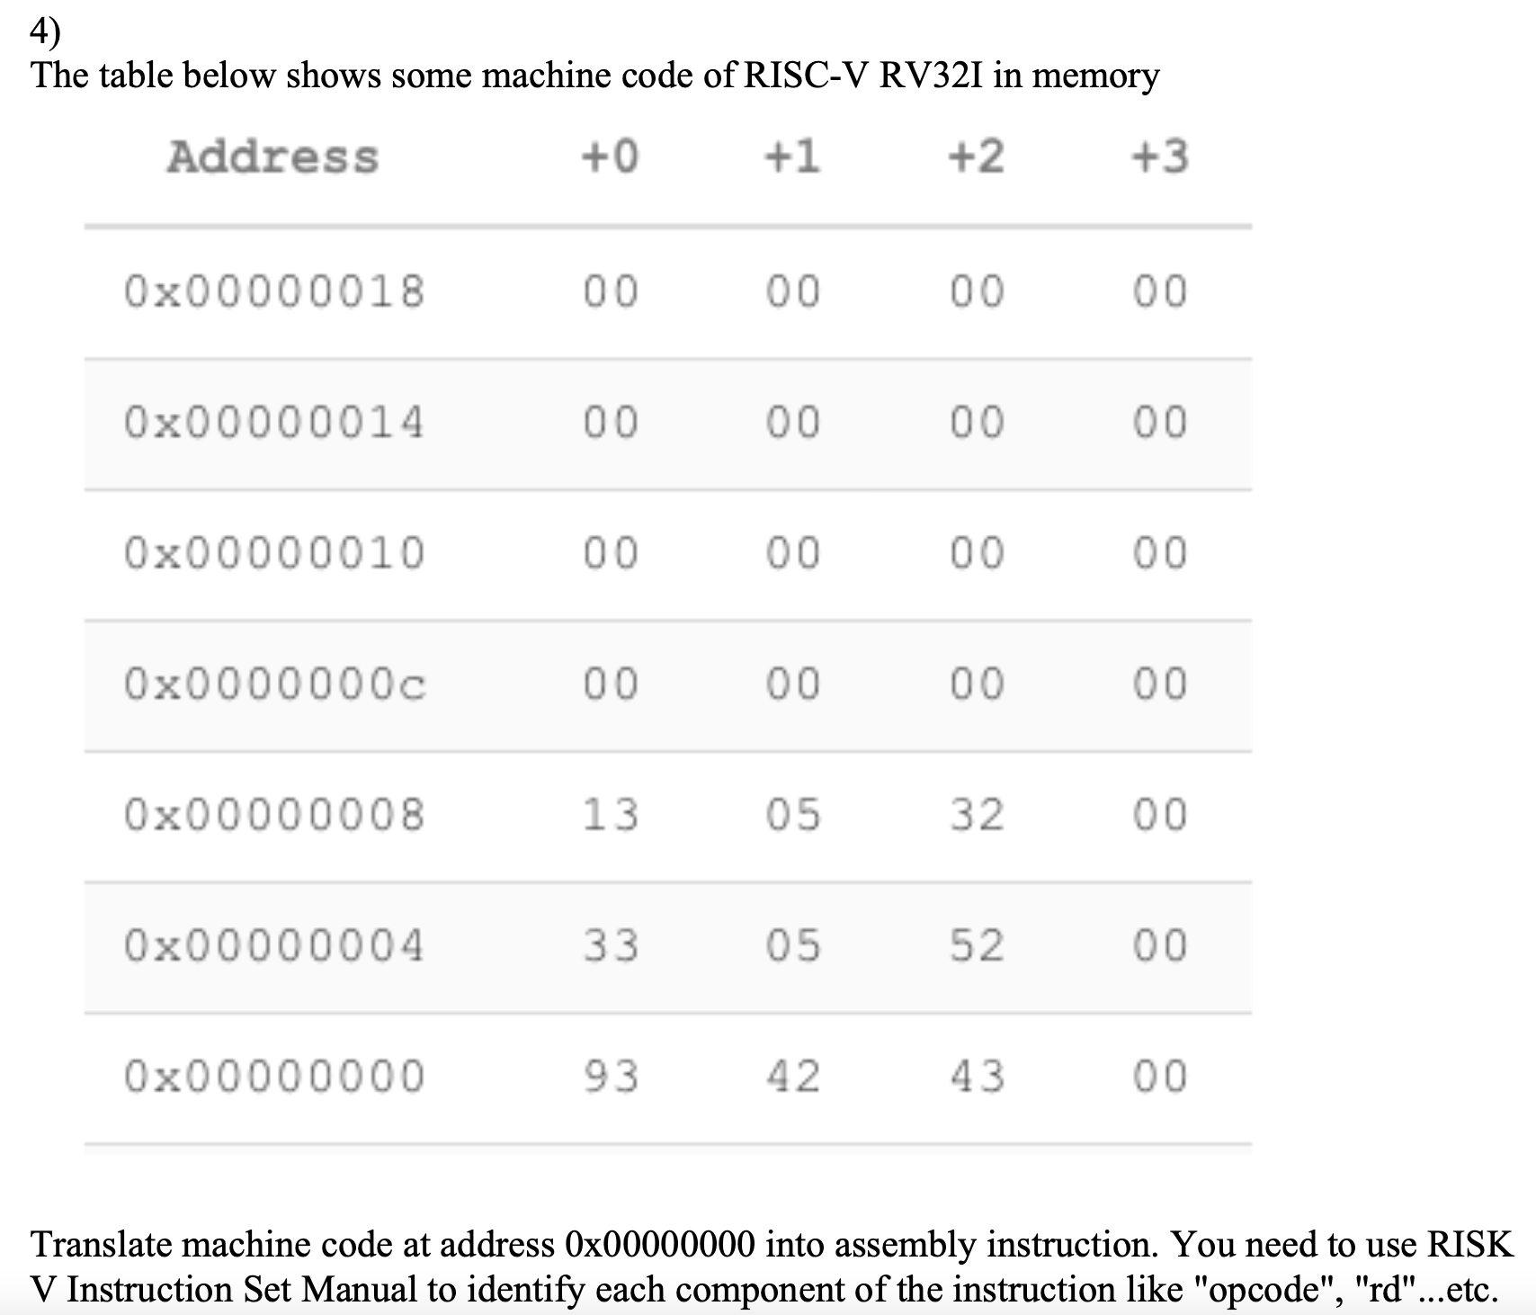
Midterm Review
Is there time?
  Question #4 was the hardest
Let’s do it from scratch, without referencing solutions
  Note: I wrote the solution on the board. If you have any questions, please email me.

Slide 51
THE END

